Slide 1
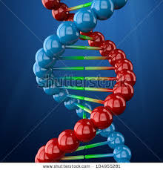
The Baby Looks Like Who?
Pre-lab

Slide 2
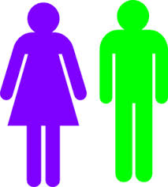
Gender
Girls = XX
Boys = XY

Slide 3
Face Shape
Round = RR, Rr
Square = rr

Slide 4
Chin Shape
Noticeable = NN, Nn
Less Noticeable = nn

Slide 5
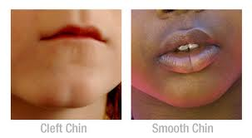
Chin Dimple
Absent = NN, Nn
Cleft = nn

Slide 6
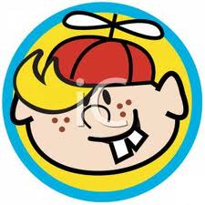
Freckles
Freckles = FF, Ff
None = ff

Slide 7
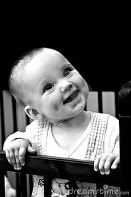
Cheek Dimples
Dimples = DD, Dd
None = dd

Slide 8
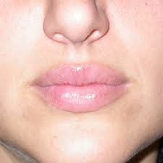
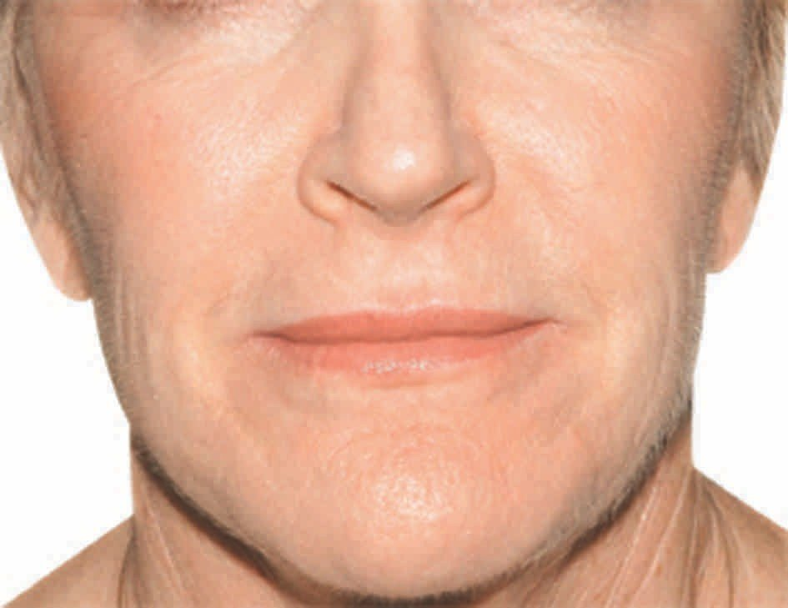
Lip Thickness
Thick = TT, Tt
Thin = tt

Slide 9
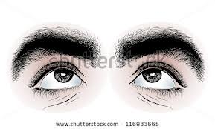
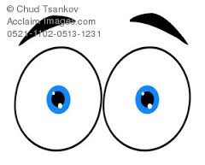
Eye Brows
Bushy = BB, Bb
Fine = bb

Slide 10
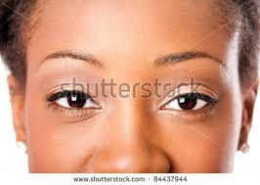
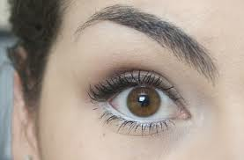
Eye Shape
Wide/Almond = WW, Ww
Round = ww

Slide 11
Eyelashes
Long = LL, Ll
Short = ll

Slide 12
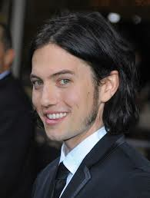
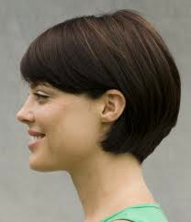
Ear Shape
Long/Large = EE, Ee
Small = ee

Slide 13
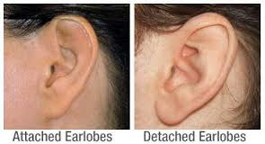
Earlobes
Detached/Free = GG, Gg
Attached = gg

Slide 14
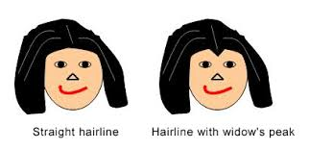
Widow’s Peak
Widow’s Peak = KK, Kk
Straight = kk

Slide 15
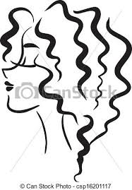
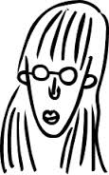
Hair Curliness
Curly = C¹C¹
Wavy = C¹C²
Straight = C²C²

Slide 16
Eyebrow Color
Darker than hair = J¹J¹
Same as hair = J¹J²
Lighter than hair = J²J²

Slide 17
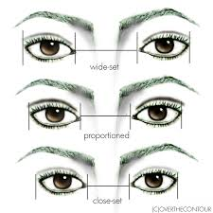
Eye Width
Close together = U¹U¹
Average = U¹U²
Far apart = U²U²

Slide 18
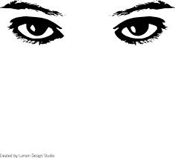
Eye Size
Large = S¹S¹
Medium = S¹S²
Small = S²S²

Slide 19
Mouth Size
Wide = Z¹Z¹
Medium = Z¹Z²
Narrow = Z²Z²

Slide 20
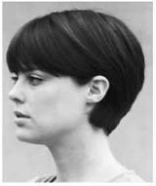
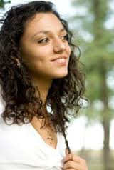
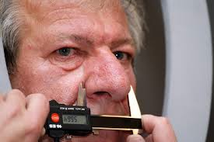
Nose Size
Small = O¹O¹
Medium = O¹O²
Large = O²O²

Slide 21
Birth Mark/Mole
Left cheek= M¹M¹
Right cheek = M¹M²
Absent = M²M²

Slide 22
Skin Tone
Light = P¹P¹
Medium = P¹P²
Dark = P²P²

Slide 23
Hair Color
Black = HHCC, HHCc
Red = HHcc
Dark Brown = HhCC
Light Brown = HhCc
Dark Blond = Hhcc
Blond = hhCC, hhCc
White = hhcc

Slide 24
Eye Color
Deep Brown = QQVV, QQVv
Brown = QQvv
Greenish Brown = QqVV
Light Brown = QqVv
Gray-blue = Qqvv
Green = qqVV
Light blue = qqVv
Pink = qqvv

